Slide 1
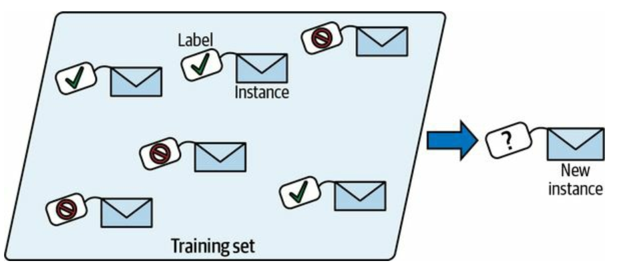
Supervised Learning: Classification
Classification in machine learning is a type of supervised learning where the goal is to categorize or classify data points into predefined classes or labels.
Given input data (features), a classification algorithm learns a mapping function that assigns a label (or class) to each data point based on the training data. It is used when the output variable is categorical, meaning it falls into one of several distinct categories.
Examples of Classification Algorithms:
Logistic Regression
K-Nearest Neighbors (KNN)
Decision Trees
Naive Bayes
Support Vector Machine (SVM)
Random Forest
Neural Networks

Slide 2
Supervised Learning: Classification
K-Nearest Neighbors (KNN)
It is a simple, non-parametric, instance-based machine learning algorithm. It can be also used as regression tasks.
Non-parametric: k-NN doesn’t assume any specific form for the underlying data distribution, which makes it flexible for various data types. It can model complex data patterns without needing to fit data to a predefined parameterized function.
Instance-based: Instead of learning a general rule from the training data, k-NN memorizes the entire training set. For prediction, it looks up the k closest instances in the training data (based on a distance metric like Euclidean or Manhattan) and uses those instances to classify new points or make regression predictions.

Slide 3
Supervised Learning: Classification
K-Nearest Neighbors (KNN)
KNN works by finding the "k" closest data points (neighbors) to a new, unknown data point and making predictions based on their classes.
KNN does not build a model during the training phase. Instead, it stores the training data and makes predictions by referencing it directly during testing. This is why it is also called a lazy learner.
Advantages of KNN:
KNN is easy to understand and implement. Since KNN doesn’t build a model, the training phase is fast. It can be used for both classification and regression problems. KNN doesn’t make assumptions about the underlying data distribution (Non-parametric).

Slide 4
Supervised Learning: Classification
How KNN Works:
Select k Neighbors: The parameter "k" refers to the number of nearest neighbors to consider when making a prediction.
Calculate Distance: The algorithm calculates the distance between the new data point and all other points in the training dataset. Common distance metrics include: Euclidean Distance, Manhattan Distance.
Identify Nearest Neighbors: After calculating the distances, the algorithm selects the k nearest points (neighbors) from the training set.
Make a Prediction: Classification: The new point is assigned to the class that is most common among its k nearest neighbors (majority voting).

Slide 5
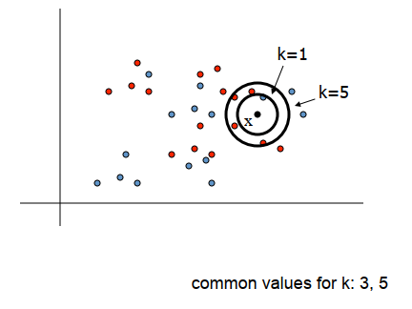
Supervised Learning: Classification
To classify a new input vector x, examine the k-closest traning data point to x and assign the object to the most frequently occurring class.

Slide 6
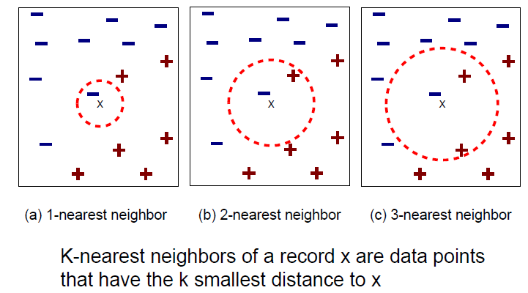
Supervised Learning: Classification
How KNN Works:

Slide 7
Supervised Learning: Classification
Example of KNN:
Height (cm) | Weight (KG) | Class
167 | 51 | Underweight
182 | 62 | Normal
176 | 69 | Normal
173 | 64 | Normal
172 | 65 | Normal
174 | 56 | Underweight
169 | 58 | Normal
173 | 57 | Normal
170 | 55 | Normal
170 | 57 | ?

Slide 8

Supervised Learning: Classification
Example of KNN:
$$d=\sqrt{{\left(x_{2}−x_{1}\right)}^{2}+{\left(y_{2}−y_{1}\right)}^{2}}$$
$$d_{1}=\sqrt{{\left(170−167\right)}^{2}+{\left(57−51\right)}^{2}}$$
$$d_{2}=\sqrt{{\left(170−182\right)}^{2}+{\left(57−62\right)}^{2}}$$
.
.
.
$$d_{9}=\sqrt{{\left(170−170\right)}^{2}+{\left(57−55\right)}^{2}}$$
Height (cm) | Weight (KG) | Class
167 | 51 | Underweight
182 | 62 | Normal
176 | 69 | Normal
173 | 64 | Normal
172 | 65 | Normal
174 | 56 | Underweight
169 | 58 | Normal
173 | 57 | Normal
170 | 55 | Normal
170 | 57 | ?

Slide 9
Supervised Learning: Classification
Example of KNN:
Height (cm) | Weight (KG) | Class | d
167 | 51 | Underweight | 6.7
182 | 62 | Normal | 13
176 | 69 | Normal | 13.4
173 | 64 | Normal | 7.6
172 | 65 | Normal | 8.2
174 | 56 | Underweight | 4.1
169 | 58 | Normal | 1.4
173 | 57 | Normal | 3
170 | 55 | Normal | 2
170 | 57 | ?

Slide 10
Supervised Learning: Classification
Example of KNN:
Height (cm) | Weight (KG) | Class | d | Rank
169 | 58 | Normal | 1.4 | 1
170 | 55 | Normal | 2 | 2
173 | 57 | Normal | 3 | 3
174 | 56 | Underweight | 4.1 | 4
167 | 51 | Underweight | 6.7 | 5
173 | 64 | Normal | 7.6 | 6
172 | 65 | Normal | 8.2 | 7
182 | 62 | Normal | 13 | 8
176 | 69 | Normal | 13.4 | 9
170 | 57 | ?

Slide 11
Supervised Learning: Classification
Example of KNN:
Height (cm) | Weight (KG) | Class | d | Rank
169 | 58 | Normal | 1.4 | 1
170 | 55 | Normal | 2 | 2
173 | 57 | Normal | 3 | 3
174 | 56 | Underweight | 4.1 | 4
167 | 51 | Underweight | 6.7 | 5
173 | 64 | Normal | 7.6 | 6
172 | 65 | Normal | 8.2 | 7
182 | 62 | Normal | 13 | 8
176 | 69 | Normal | 13.4 | 9
170 | 57 | ?
K=3

Slide 12
Supervised Learning: Classification
Example of KNN:
Height (cm) | Weight (KG) | Class | d | Rank
169 | 58 | Normal | 1.4 | 1
170 | 55 | Normal | 2 | 2
173 | 57 | Normal | 3 | 3
174 | 56 | Underweight | 4.1 | 4
167 | 51 | Underweight | 6.7 | 5
173 | 64 | Normal | 7.6 | 6
172 | 65 | Normal | 8.2 | 7
182 | 62 | Normal | 13 | 8
176 | 69 | Normal | 13.4 | 9
170 | 57 | ?
K=4

Slide 13
Supervised Learning: Classification
Example of KNN:
Height (cm) | Weight (KG) | Class | d | Rank
169 | 58 | Normal | 1.4 | 1
170 | 55 | Normal | 2 | 2
173 | 57 | Normal | 3 | 3
174 | 56 | Underweight | 4.1 | 4
167 | 51 | Underweight | 6.7 | 5
173 | 64 | Normal | 7.6 | 6
172 | 65 | Normal | 8.2 | 7
182 | 62 | Normal | 13 | 8
176 | 69 | Normal | 13.4 | 9
170 | 57 | ?
K=5

Slide 14
Supervised Learning: Classification
Disadvantages of KNN:
Computationally Expensive: As the size of the dataset increases, the algorithm becomes slow because it has to calculate the distance for each test point with every training point.
Sensitive to Noisy Data: Outliers or irrelevant features can significantly affect predictions.
Feature Scaling Required: Since KNN relies on distance calculations, features must be scaled properly to prevent features with larger ranges from dominating the distance calculation.
Memory-Intensive: The algorithm needs to store the entire training dataset, making it less memory-efficient for large datasets.

Slide 15
Supervised Learning: Classification
KNN Code:
https://colab.research.google.com/drive/1WvzjLHrb2Yf0ocPfUPUAIL7lYTIAvGwl?usp=sharing
Lets go for understanding the coding of KNN using Python

